Slide 1

Outram Research Ltd
Fault Level
John Outram www.outramresearch.co.uk

Slide 2
Fault Level
Accurate fault level - The challenge facing planners and operations managers
An alternative to modelling
Slow-time and real-time fault level measurement – exploiting network disturbances – a solution
Benefits and savings – a Case study

Slide 3
The Challenge arising…
Ageing infrastructure
Potential for increasing faults
Increasing significance of customer minutes lost
Loss of well-understood generation capacity
Increase in Distributed Generation
Increased demand for connection

Slide 4
Plus we must aim for…
Increased efficiency
Best utilisation of network capacity
Maximum use of other resources
At the same time as…
Keeping the network safe
Maintaining/Increasing security of supply.

Slide 5
What do we mean by Fault Level?
Fault Level, Fault Current, Prospective Fault Level all mean the same thing…
The worst case current that can
flow in the event of a fault.
It is also expressed as Power on all three phases,
i.e. Fault Current x Nominal Voltage (P-N) x 3
It is the current
we must interrupt safely
for which the infrastructure must be designed.

Slide 6
Put another way…
Given an infrastructure and existing protection circuitry there is a
maximum fault level that can be accommodated
in that section of the infrastructure.
It is the operator’s responsibility to keep the Fault Level available from the generation system below this critical infrastructure limit…. And without knowing the Fault Level….

Slide 7


Slide 9
Fault Level is affected by
Static contributors
  Cables/Transformers/Breakers etc.,
Dynamic contributors
  Sub-transient & Transient reactances
  Short term Motor contribution
  Distributed Generation
  (as well as the nominal Voltage!)

Slide 10
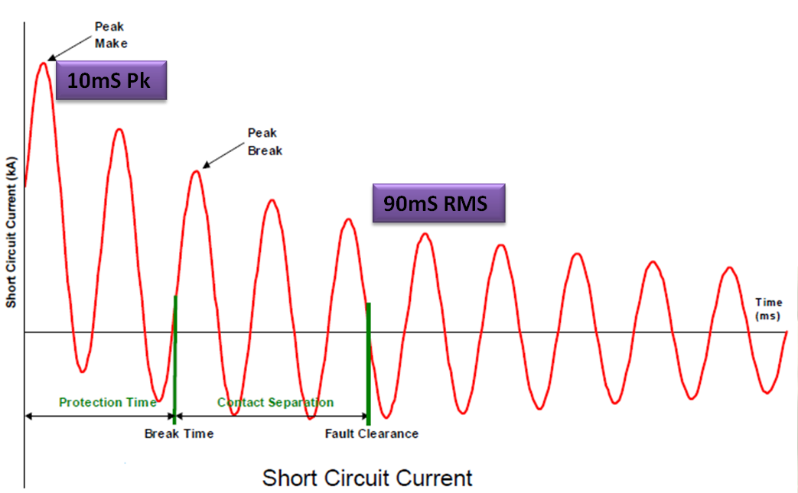
Fault Current waveshape
(c) Scottish Power

Slide 11
  Components of Fault Level dominated by
  Total source impedance, Zsource, from all relevant generators and forcing voltage
  DC offset – arising from inductive Zsource, and ratio of Inductive (X) to resistive(R) components of the source impedance. (difficulty of getting current through an inductor to change abruptly) Decay is slowest for high X/R ratios
  Decaying sources e.g. upstream or downstream motor contribution, PV (?)

Slide 12
Application of this knowledge: to Cable/Infrastructure rating, Breaker selection
  RMS Break. Choose a Breaker rating to exceed the maximum Fault Level arising just before the “open” action.
  e.g. If Breakers are to open at say 100 - 120ms after fault inception, specify a Breaker rating greater than the Fault Level at T, where T is some time before the 100ms minimum opening instance – e.g. 90ms.

Slide 13
Application of this knowledge:
Breaker selection
  Peak Make. The breaker may have Peak Make rating at some fixed multiple of the RMS Break rating. In some countries typically 2.55 corresponding to an X/R ratio of 14.
  If the anticipated X/R ratio and the corresponding multiple is expected or measured to exceed this, then consider whether the RMS Break level of the breaker should be de-rated.
  e.g. If Breakers are to open at say 100 - 120ms after fault inception, specify a Breaker rating greater than the Fault Level at T, where T is some time before the 100ms minimum opening instance – e.g. 90ms.

Slide 14
Historically…
Knowledge through modelling
Assume a high quality mathematical tool, then need to
Know All Relevant Network Characteristics, e.g.
Fixed network features:
  Transmission medium, Cables, Isolators, Transformers, Breakers, Joints
Operational or temporary features:
  Switching arrangements, Motors, Distributed Generation, Mitigation devices

Slide 15
Application of modelling in the UK
HV - >= 132kV - comprehensive
MV - > 33kV - large scale
LV - <= 11kV - on demand, not
necessarily kept up to date

Slide 16
Limitations of modelling
Time to build
Could be based on incomplete or incorrect information
Consequences
Is it accurate?
Use models conservatively depending on care with which they are built.

Slide 17
An Alternative…
Knowledge through measurement.
Fault Level Monitor (FLM)
- a complementary tool
? What about where
Network characteristics not known?
Characteristics are variable e.g. DG?
Computer model needs validation?

Slide 18
Consideration of Network behaviour
Network behaviour MUST be indicative of network characteristics……
Characteristics ➔ Behaviour
Can we work this backwards?
Behaviour ➔ Characteristics ➔ Fault Level

Slide 19
Behaviour
Means:
Response to disturbances
The best disturbances are little mini-faults

Slide 20
FLM – a tool to MEASURE and exploit network behaviour
Base it on e.g. Power Quality Analyser
Already examining network characteristics:
Robust, Safe, Sub-Station ready, operate at wide voltage levels
May sample fast enough and have enough processing capacity
Use natural disturbances
Potentially applicable to any voltage level if VTs, CTs available
Or artificial disturbances
Optionally create small disturbances to give information to work on (may involve additional hardware.)

Slide 21

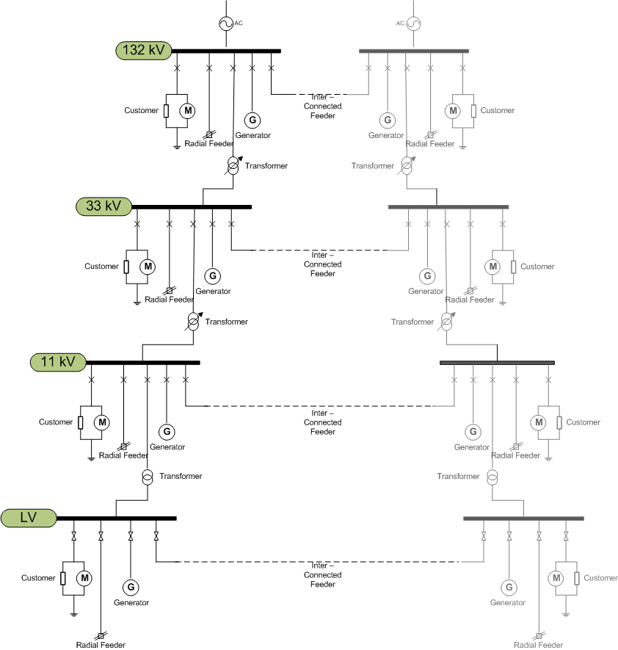
Possible FLM connection points

Slide 22
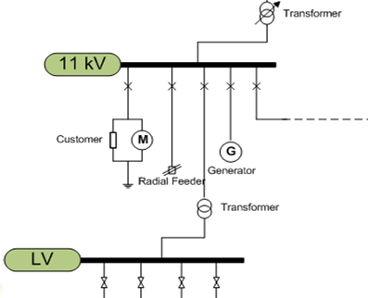
Example FLM Connection
Make connection and measurement HERE

Slide 23
Using Natural Disturbances
Advantage:
Small, low power, portable
Passive (Non-invasive)
Easy to use
Limitations:
Variable-time
Must be on a Radial network or a radiallised section of an interconnected network.

Slide 24
Natural Disturbances available
DOWNSTREAM changes e.g.
    Load variation on feeder (or piece of network) of interest:
    Produce changes in current and consequent changes in voltage dependent on UPSTREAM characteristics
UPSTREAM voltage changes e.g.
Tap changes, or load variation on other feeders:
    Produce changes in current dependent on DOWNSTREAM characteristics

Slide 25
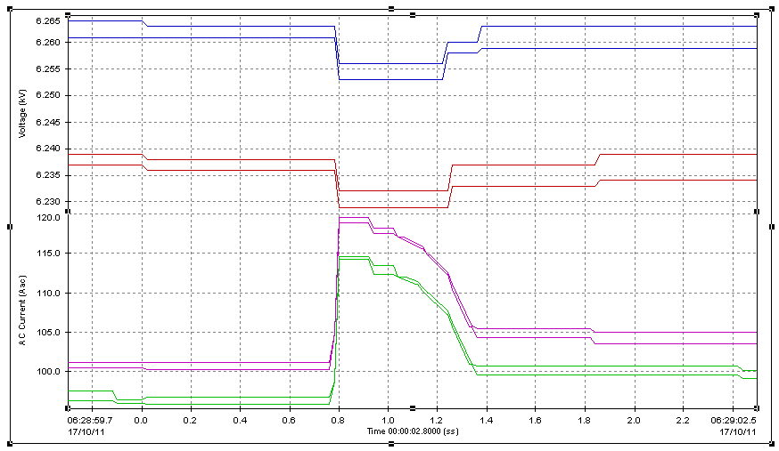
Natural Downstream disturbance
3 seconds on screen – 0.1% voltage, 18A
Yields Upstream information

Slide 26
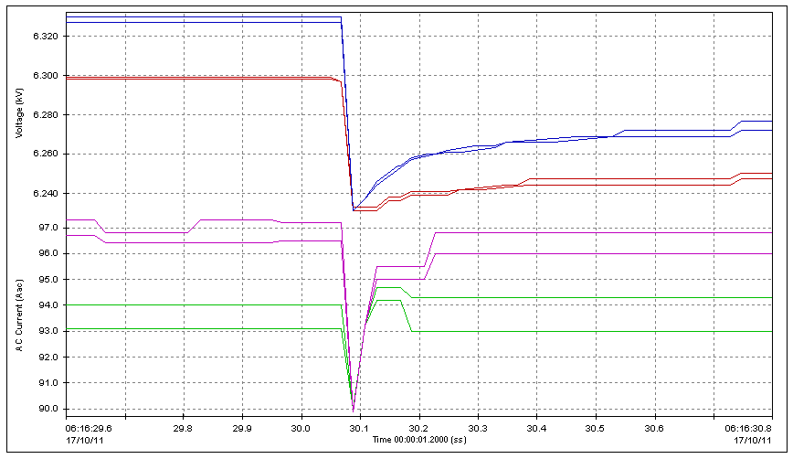
Upstream disturbance - 1 second on screen, 1-1.5% Voltage, 3-7A (Asymmetrical event)
Yields Downstream information

Slide 27
Using Natural Disturbances
Advantage:
Small, low power, portable
Passive (Non-invasive)
Easy to use
Limitations:
Variable-time
Must be on a Radial network or a radiallised section of an interconnected network.

Slide 28
Applying artificial disturbances

Slide 29
Using artificial disturbances
Advantage:
Real-time on demand.
Radial - by design.
  The current sensors see ALL the current change, so it will work for interconnected network and it will automatically combine upstream and downstream components.
Disadvantage:
Needs substantial hardware

Slide 30
A real example –
Artificial Disturbances
Negligible Power Quality impact unless repeated frequently.
~1% Voltage disturbance on Vac only for 1 cycle (twice).
Can yield combined information

Slide 31
Design FLM solution to give
RMS “Break” Fault Level, selectable time T (e.g. 90ms) after Fault Inception
Peak “Make” Fault level, ½ cycle after Fault Inception
Motor contribution from attached loads (also at ½ cycle)

Slide 32
Sources of Error
Systematic errors:
  VT and CT errors, especially phase errors
  Network not representative – e.g. motors not present
Random errors:
  Instrumentation noise
  Background Network noise
  Low Disturbance level (or lack of disturbances)
  BUT REMEMBER – The goal also includes reducing need to rely on possibly inadequate model data

Slide 33
Initial Difficulties
Such products have not been available – how do we know it works?
Test sites non-existent –
  Difficulty of comparison against real faults
Motors not present –
What assumptions should be made, if any.
Are the existing modelling assumptions relevant (e.g. 1 MVA of motor contribution per x MVA of load

Slide 34
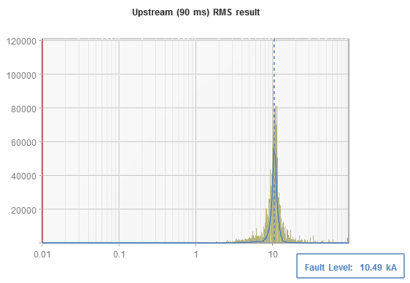
What kind of result should we expect?
Accumulated Incidence x size of disturbance
For a noisy network, we must expect a noisy set of results.
Show results over a period of time as a Probability Density Function (PDF)
Fault Level Current (kA)

Slide 35
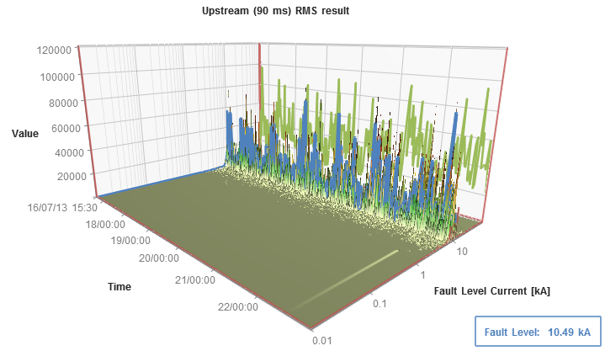
As a 3D surface plot, or series of PDFs describing a longer period of time – e.g. a day, week or month

Slide 36
How well can this system work?
11kV tests of PM7000 FLM at S & C Electric, Chicago, USA, July 2012, using pairs of very short (5ms), fairly high current (500A) pulses.
(With Western Power Distribution – approx. ¼ of UK)
Fault Level Results
 | Predicted | Actual | Error
Peak | 30.63kA | 31.34kA | 2.26%
RMS | 12.72kA | 13.10kA | 2.90%

Slide 37
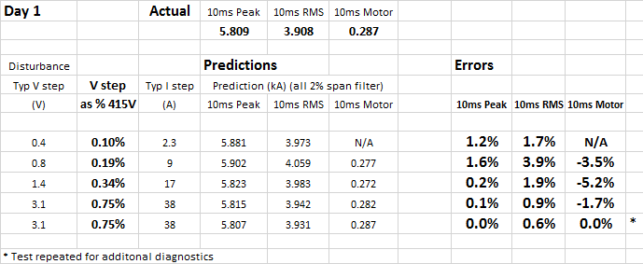
How well can this system work?
LV tests of PM7000 FLM at Kelvatek, 29th May 2013
(With Scottish Power Energy Networks - approx. 1/7 of UK )

Slide 38
Case Study 1.
Different numbers of Transformers
Reading town (pop. 155,000) typically served at 11kV by two parallel transformers. SSE wanted to validate their models for 2, 1 and 3 transformer running.
FLM connected to feeder serving town centre (offices)
Ran 1 week (normal 2 transformers)
Check results. 1 transformer running approved
Ran 1 week (1 transformer)
Ran 1 week (3 transformers)

Slide 39
Voltage and current envelope showing daily/weekly load variation

Slide 40
Voltage and current envelope one day with small spikes visible

Slide 41
Example small spike
25A produced ~40V = 0.4% variation

Slide 42
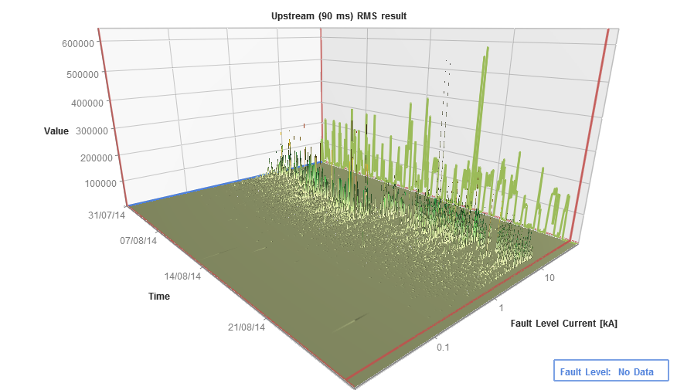
Reading Town – 3 week trial
90ms RMS Fault Level

Slide 43
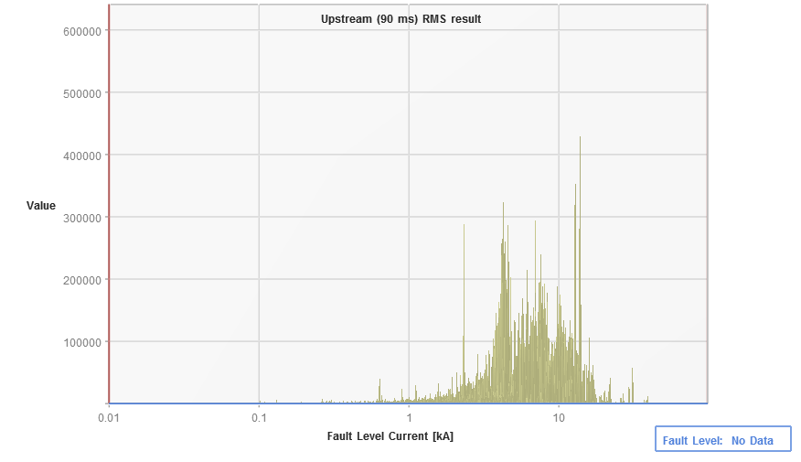
Probability Density Function
(PDF) for full period

Slide 44
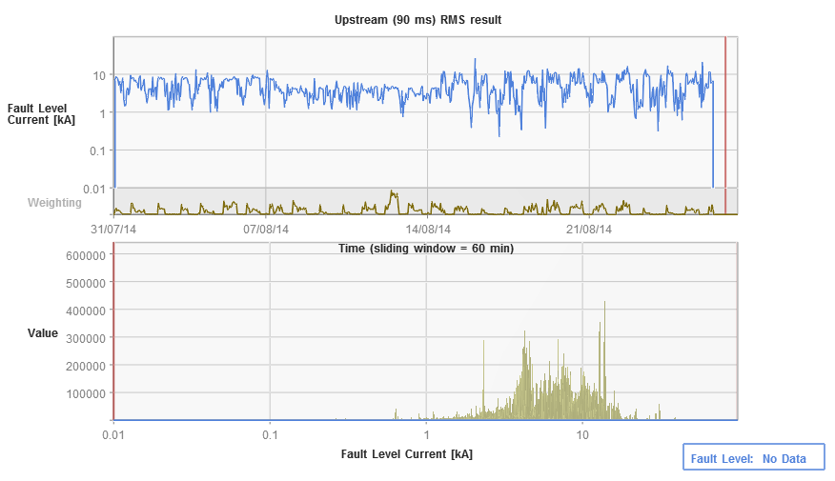
Individual 30 min. interval results, weighting & PDF

Slide 45
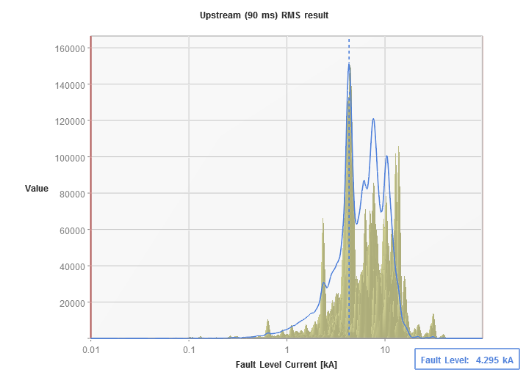
Probability Density Function
(PDF) with filtering, for full period (blue line)

Slide 46
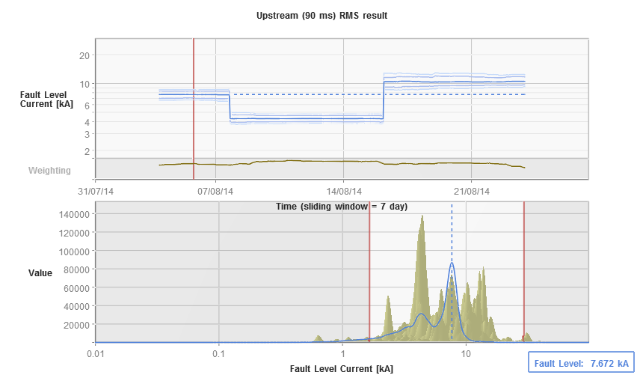
Time graph and PDF with filtering, for 7 day sections(blue line)

Slide 47
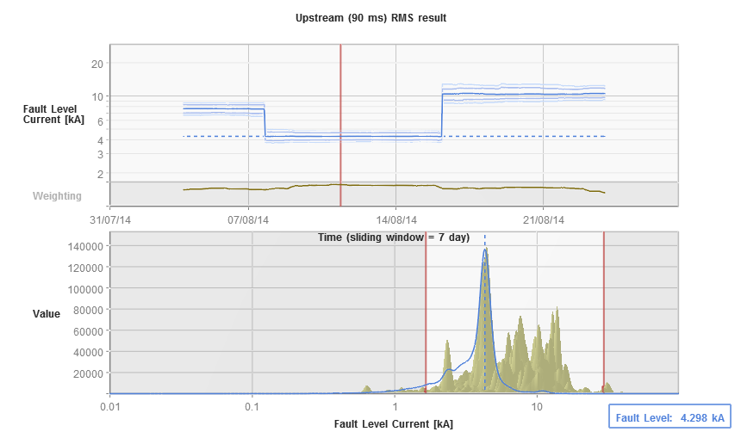
Time graph and PDF with filtering, for 7 day sections(blue line)

Slide 48
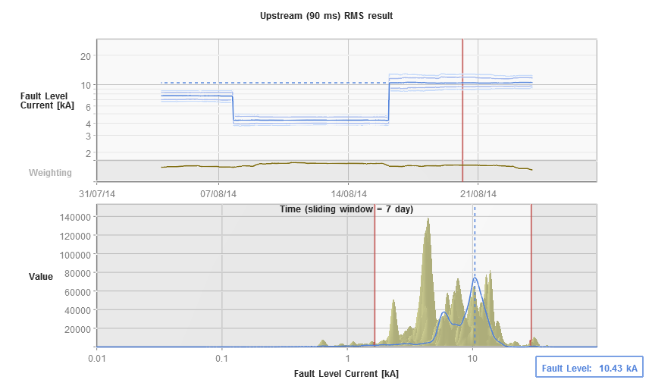
Time graph and PDF with filtering, for 7 day sections(blue line)

Slide 49

Case study 2.
Chester city centre.
Normally run as a four-transformer meshed group
Scottish Power want more security of supply
A fifth transformer is available, but can it be used?
Planners say NO (excessive Fault level)

Slide 50
Proposition the planners to:
Model four group operation as accurately as possible
Measure using FLM
Compare with model.

Slide 51
Proposition the planners to:
Model four group operation as accurately as possible
Measure using FLM
Compare with model.
If comparable, and well below fault level, then
Model five group
If result still adequately below fault level, then
Switch in fifth transformer, and do short measurement with FLM
Compare with model

Slide 52
Proposition the planners to:
Model four group operation as accurately as possible
Measure using FLM
Compare with model.
If comparable, and well below fault level, then
Model five group
If result still adequately below fault level, then
Switch in fifth transformer, and do short measurement with FLM
Compare with model
If comparable and below fault level, extend measurement
If consistently below fault level,
Obtain approval to use fifth transformer when required.

Slide 53
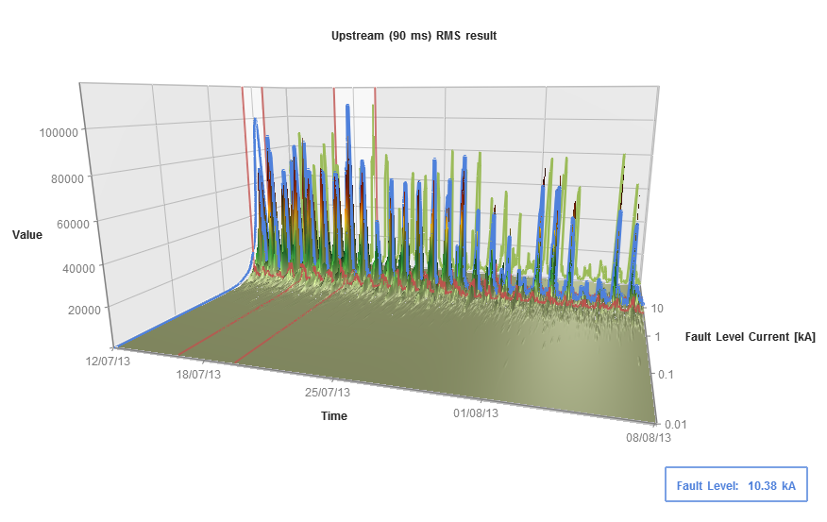
3D result showing test period
Daily variation in disturbance energy visible

Slide 54
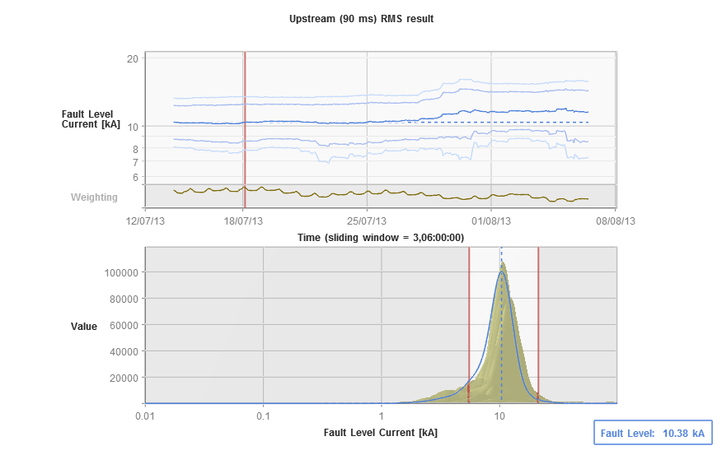
3D result showing test period and change in Fault level

Slide 55
Results at FLM location
      Four group model (IPSA) 10.16kA*
      Four group FLM 10.19 kA*
      Five group model (IPSA) 11.68 kA**
      Five group FLM 11.14 kA**
* Confidence gained that the IPSA model is accurate for Period 1 (4 Group) as the FLM result is ~0.3% out
** Results generated by FLM over the 2 weeks in Period 2 (5 Group) suggest that the FL is 4.8% lower than the IPSA model predicted
Conclusion: Despite the variation between FLM results and IPSA, both sets of results indicate that the Group could be run as a 5 group, should that offer operational benefits

Slide 56
A measurement solution exists!

Slide 57

Potential Use Cases:
Identify safety risks arising from overrated switchgear
Identify additional network capacity for new connections
Validate fault level reinforcement plans
Observe the fault level contribution from connected customers
Improve existing understanding of fault level variance over several seasons / years
Validate existing network models
Identify optimum network running arrangements without exceeding fault level
Facilitate Active Network Management schemes that control network fault level
57
Notes:
When we set about the project in 2010 we knew that having a device that could measure FL would be extremely beneficial to us as a business and we could see several potential uses for an FLM
As the project has progressed and the FLM has matured we have been looking at these use cases in more detail...
The last two bullet points are what my presentation focuses on, (vii) meets our present business needs and (viii) is what we as a business would like to see the FLM develop towards

Slide 58
Other uses
Establish local Fault Level
As an aid to Harmonics planning
To advise parameters to would-be Distributed Generation operators
To help big polluters to police themselves
Inform Automatic Disconnector settings (SEECO)
Aid to Fire Retardent Index specification for Arc Flash protection clothing. FACTS/Motor contribution

Slide 59
Where Next?
‘Facilitate Active Network Management schemes that control network fault level’
Having an accurate Fault Level Monitor now opens the door to the possibility of real time Fault Level measurements from our network
In turn this could enable DNOs to operate their networks closer to their fault level limits with confidence
The FLM could be incorporated into sequenced switching and Active Network Management schemes to autonomously reconfigure the network, curtail generation and load to maintain an acceptable network fault level
59
Notes:
Challenge is to get the FLM results at the primary

Slide 60
Fault Level Monitor
Fault Level from real measurements.
John Outram www.outramresearch.co.uk

